Slide 1
Shark Attacks An Exploratory Data Analysis
Prepared by:
Brenna Wallace
Omar zaher
Jennifer wilkerson

Slide 2


Introduction
Today we would like to talk about Shark attacks.
Where do they occur?
How dangerous is a shark attack?
Does it necessarily mean it’s the end if you are attacked?
And what are most people doing whenever they are attacked by these underwater predators?
Most attacks are classified as provoked and unprovoked attacks. However, we will be taking a deeper “dive” into the data on these attacks to get a better understanding on; If we as a people, should be more cautious of the activities we like to enjoy on our coastal shores, and do they affect the likelihood of a Shark Attack?
Shark Attacks – An exploratory data analysis

Slide 3
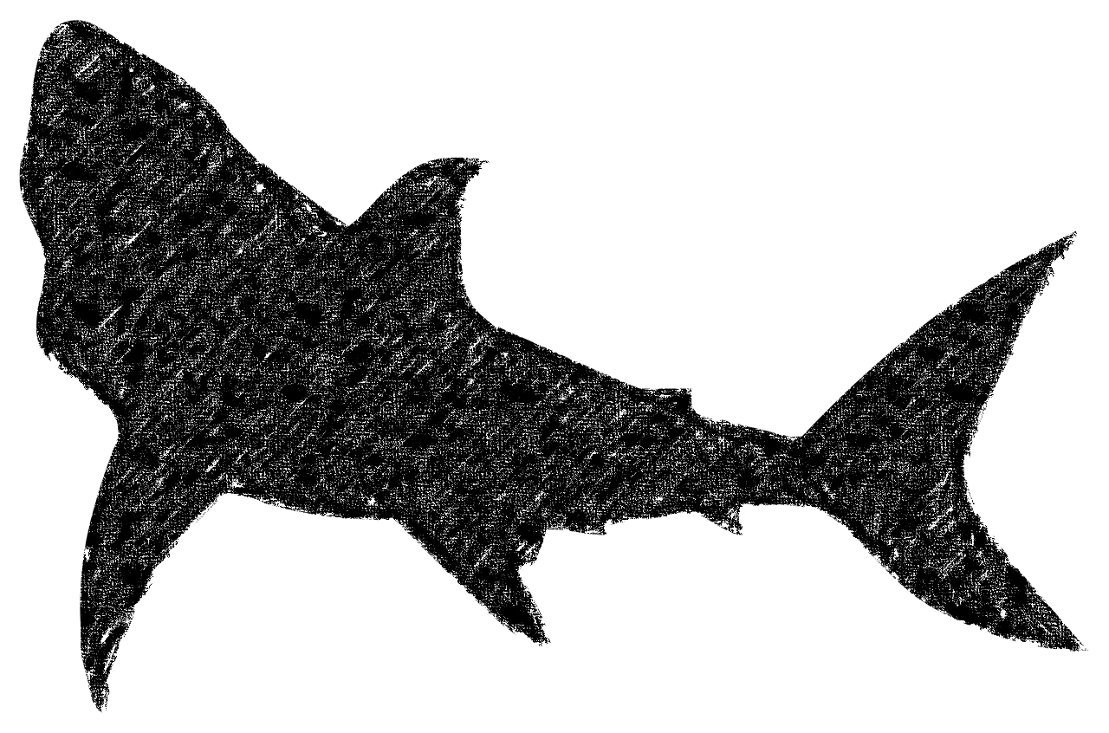
List of Contents
Introduction shark attacks
List of Contents
Research Questions
Introduction to data
Data Cleaning
Question 1
Question 2
Question 3
Regression
Limitations
Conclusion

Slide 4



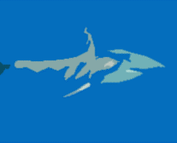
Research Questions
What reported activities are being done during a Shark attack?
How severe was the attack?
What reported month of the year do shark attacks occur most often?
Where do reported shark attacks happen most in the world?
Hypothesis: As population increases over time, reported shark attacks will also increase.

Slide 5
“Interesting fact: a shark will only attack you if you’re wet.”
Sean Lock

Slide 6
Introduction to data
The dataset we used was found on Kaggle: https://www.kaggle.com/datasets/mysarahmadbhat/shark-attacks?select=attacks.csv
The data documents global shark attacks from 1900 to 2018. These reported incidents include categories such as the activity being done when the attack happened, the location of the attack, the date & time of the attack, and if the attack was fatal.
One of our biggest tasks in this research project was to clean the data and group categories into data that could be evaluated

Slide 7
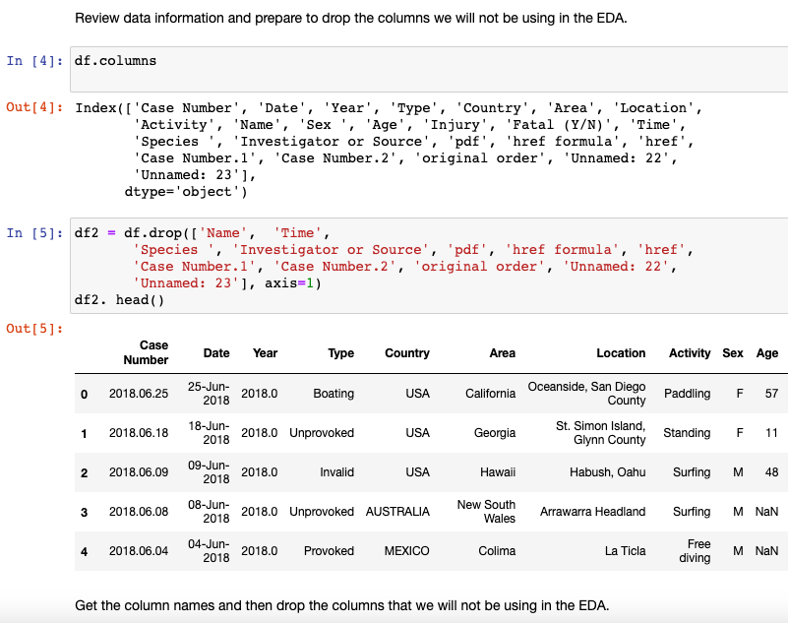
Data Cleaning
Dropping Unused Columns
Notes:
We started out with roughly 6,303 rows and 22 columns that varied in completeness.

Slide 8
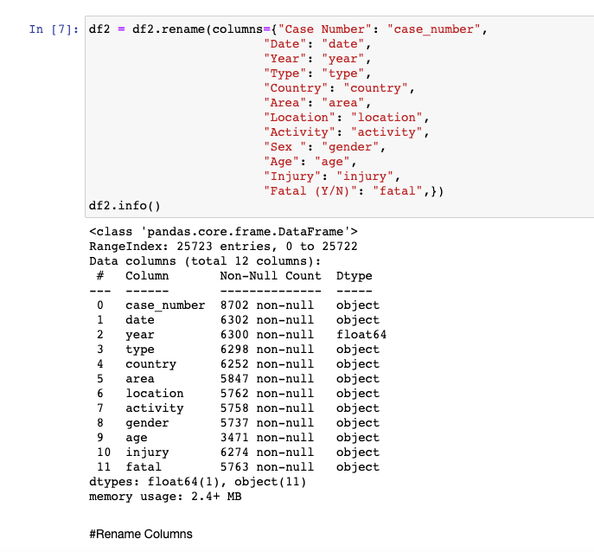
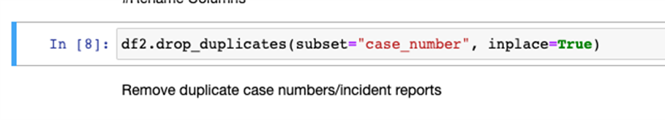
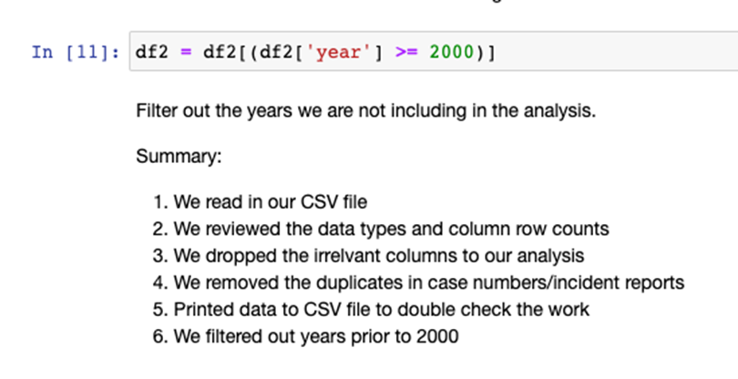
Data Cleaning
Continued
Rename Columns
Drop Duplicates
Dropped Years Before 2000

Slide 9
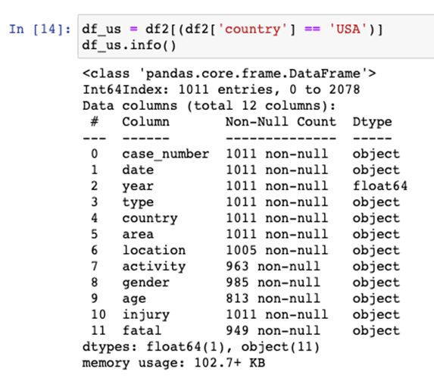
Data Cleaning
Continued
Narrowed Down Data to USA
Code
The largest amount of shark attack data to work with is from the USA.
We dropped countries other than the USA and had between 815 to 1011 rows of data to work with

Slide 10
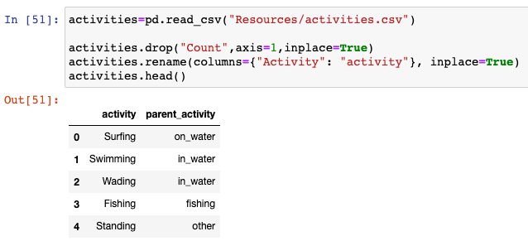
Data Cleaning
For sorting the various activities into Parent Activity groups
Parent Activity Explanation
Code
We went through our USA data frame in excel and created a parent activity group column that contained: On Water, In Water, Fishing, Science, Other. Then we read in the new csv file and merged it into our USA dataframe.

Slide 11
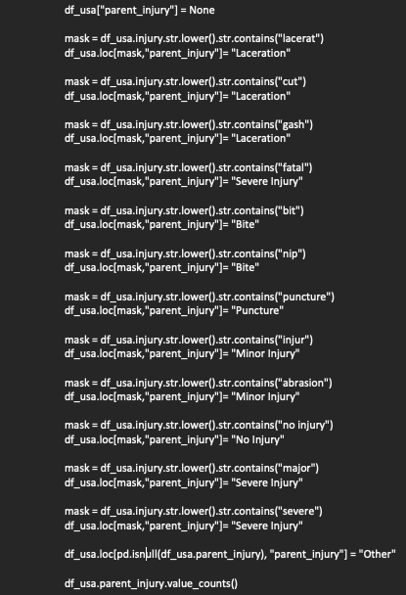
Data Cleaning
For sorting the various activities into Parent Activity groups
Parent Injury Explanation
We used string contains() masks to group injuries into parent categories.

Slide 12

Where do reported shark attacks happen most in the world?

Slide 13
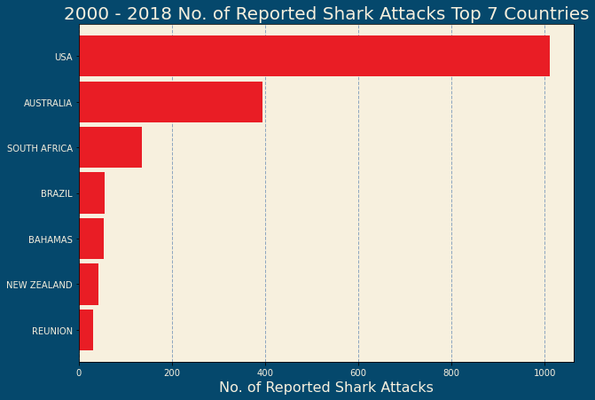
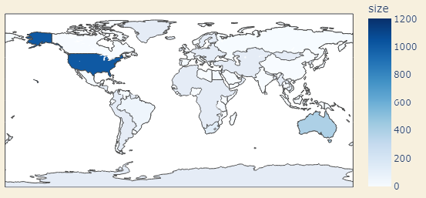
Reported Shark Attacks
Top 7 Countries
2000-2018
Shark Attacks are reported most often in the United States, followed by Australia and South Africa.
Shark Attacks – An exploratory data analysis

Slide 14
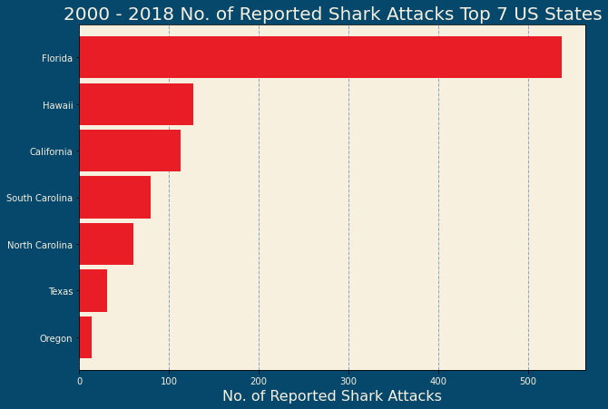
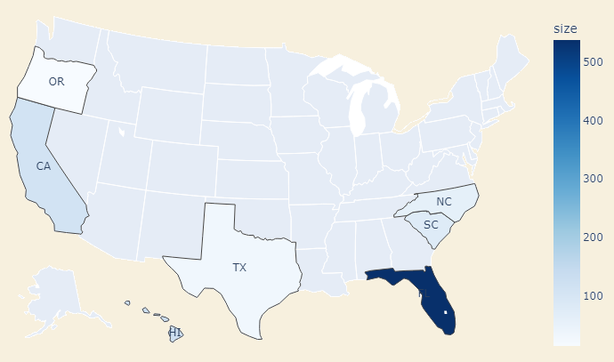
Reported Shark Attacks
Top 7 States in the USA
2000-2018
Looking at the United States only, Florida has more than 50% of the reported shark attacks, followed by Hawaii and California.
Shark Attacks – An exploratory data analysis

Slide 15

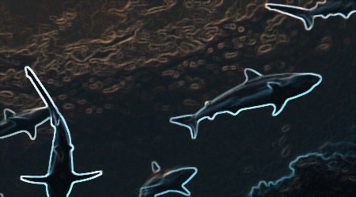
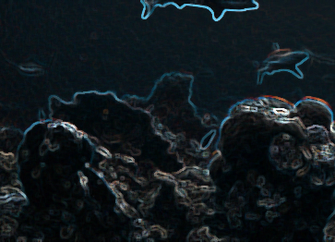
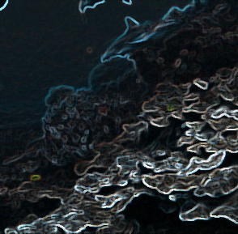
What reported activities are being done during a Shark attack?
Data is also explored by looking at age group, gender, and injury type

Slide 16
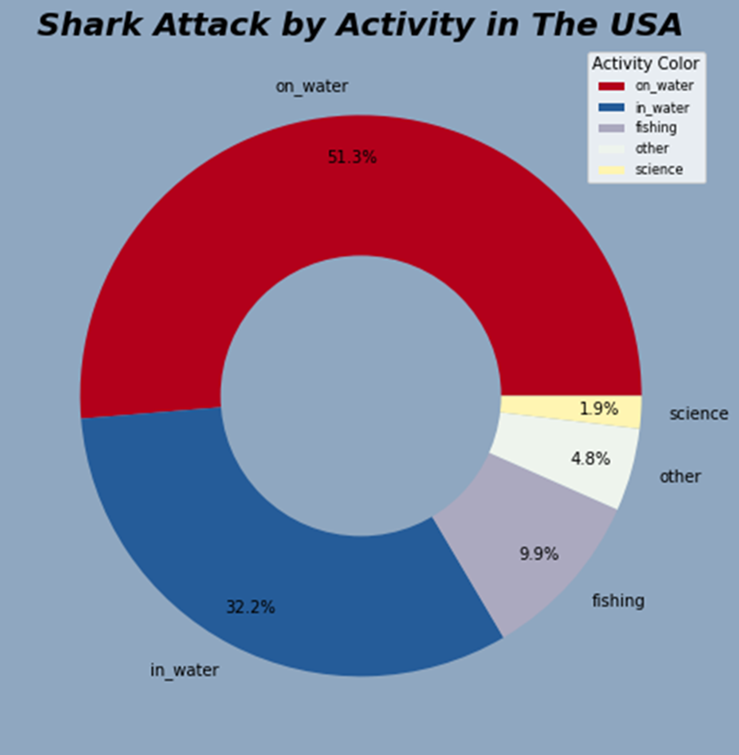
Shark Attacks by Activity
Shark Attacks in the USA
Notes:
Most shark attacks in the USA happen during activities that occur “ON” the water more than any other activity.
We can infer activities like: Surfing, Paddle boarding, Kayaking, and Jet skiing lead to a higher probability of being attacked by a shark.

Slide 17
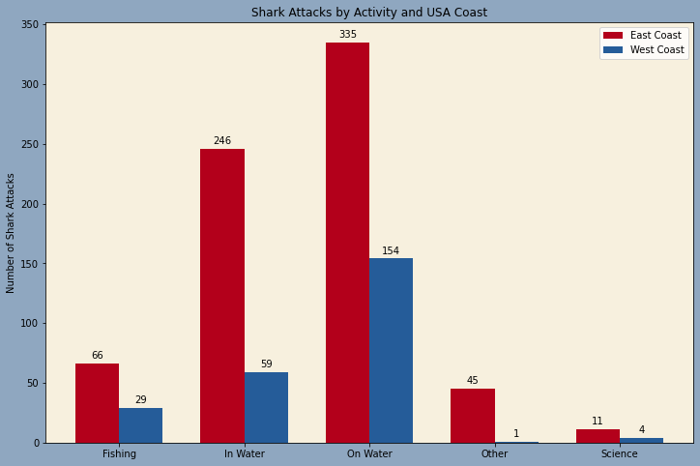
Shark Attacks by Activities on East Coast vs West Coast
Shark Attacks in the USA
Shark Attacks – An exploratory data analysis

Slide 18
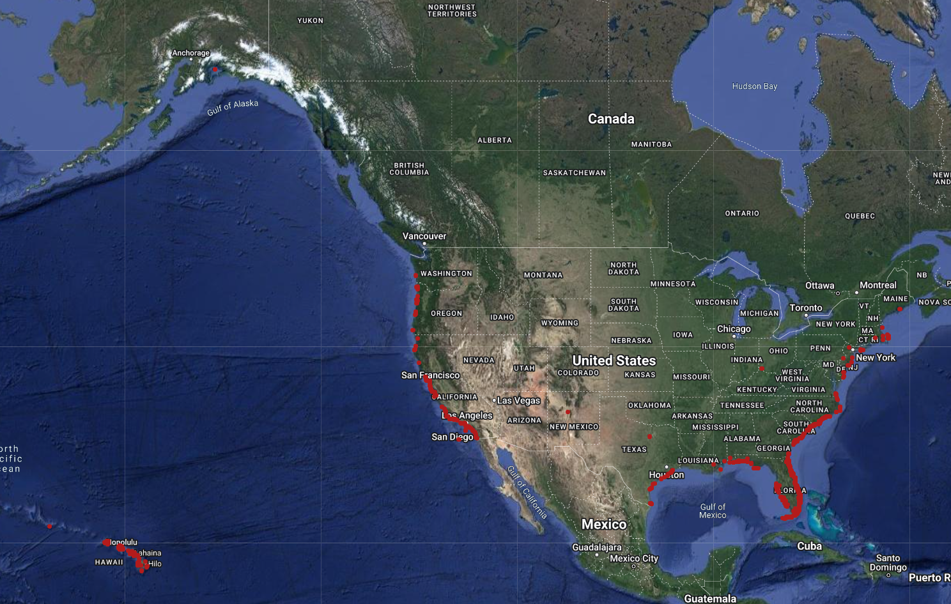
Reported Shark Attacks in the USA Map
2000-2018
Shark Attacks – An exploratory data analysis
Notes:
file:///C:/Users/brenn/SMU_Bootcamp/Projects/project_1_group_3/smu_project1_sharkattacks/smu_project1_sharkattacks/bee_work/export3.html

Slide 19
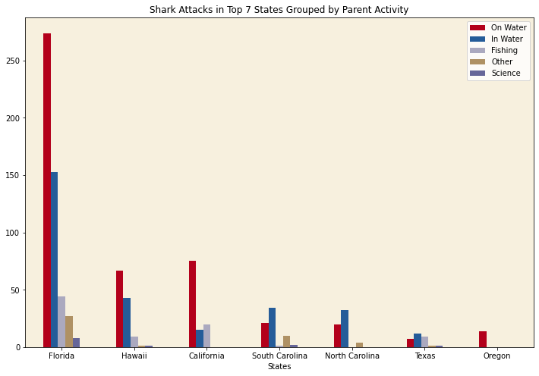
Shark Attacks – An exploratory data analysis

Slide 20
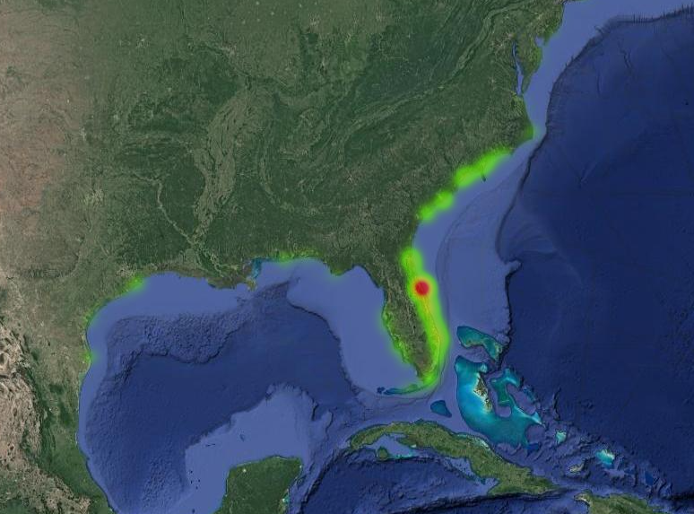
Reported Shark Attacks
Heatmap of the East Coast Line
2000-2018
Shark Attacks – An exploratory data analysis
Notes:
As we saw in the above bar graph, Florida has the most reported shark attacks with a hot spot in the New Smyrna Beach area of Florida

Slide 21
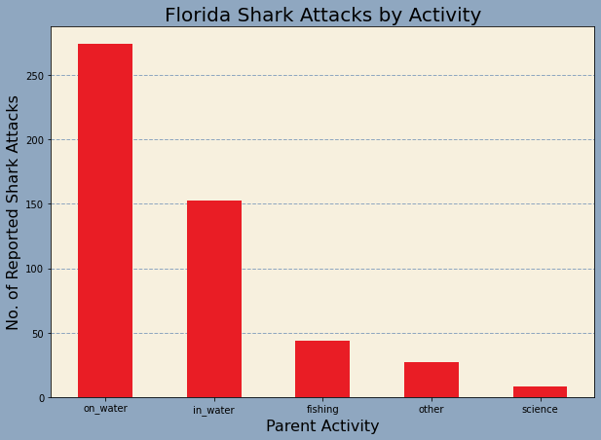
Shark Attacks by Activities in Florida
Shark Attacks in the USA
Shark Attacks – An exploratory data analysis

Slide 22
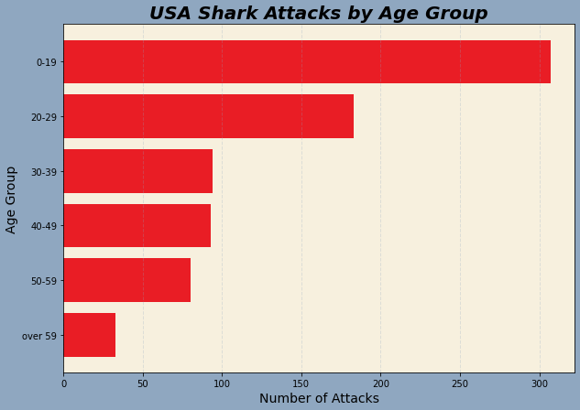
Shark Attacks by Age Group
Shark Attacks in the USA
Shark Attacks – An exploratory data analysis

Slide 23
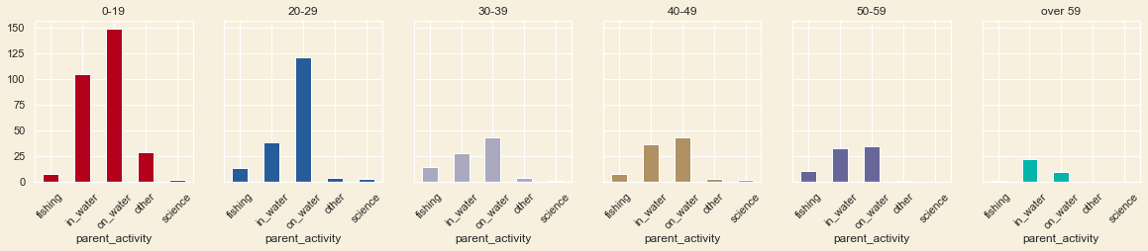
Shark Attacks by Age Group and Activities
Shark Attacks in the USA
Shark Attacks – An exploratory data analysis

Slide 24
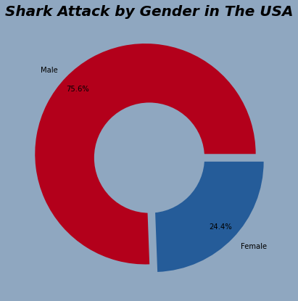
Shark Attacks by Gender
Shark Attacks in the USA
Shark Attacks – An exploratory data analysis

Slide 25
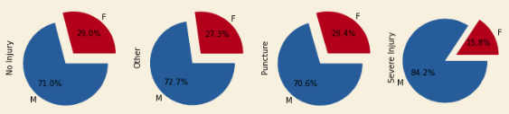
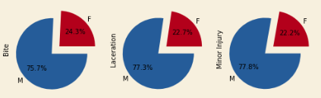
Shark Attacks by Gender and Activities
Shark Attacks in the USA
Shark Attacks – An exploratory data analysis

Slide 26
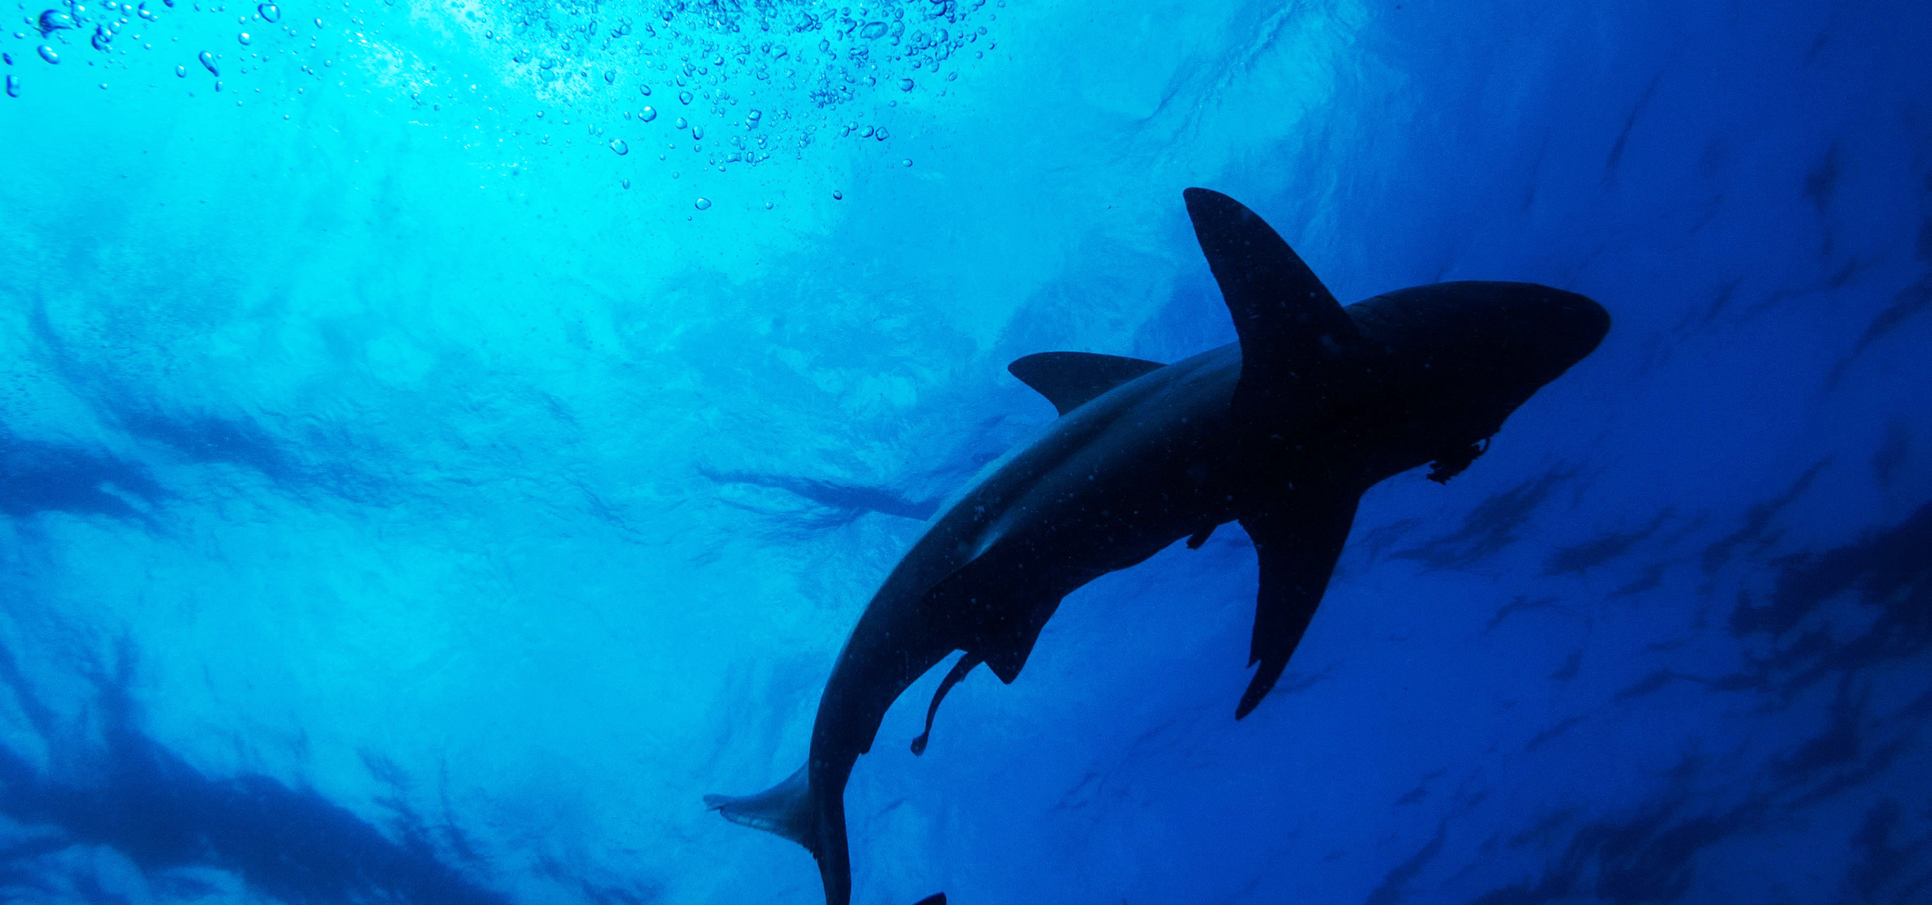
How severe was the attack?

Slide 27
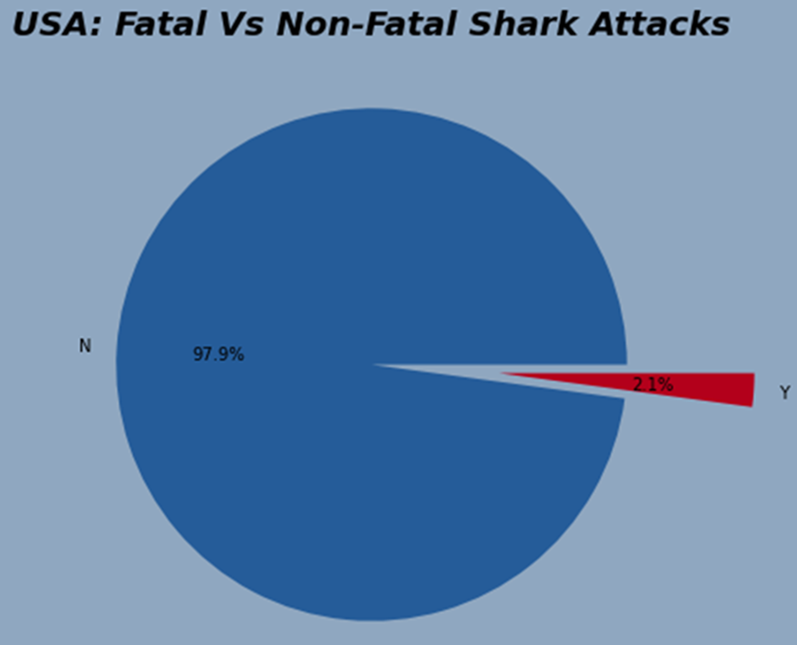
Shark Attacks Fatal Vs. Non-Fatal
Shark Attacks in the USA
Shark Attacks – An exploratory data analysis

Slide 28
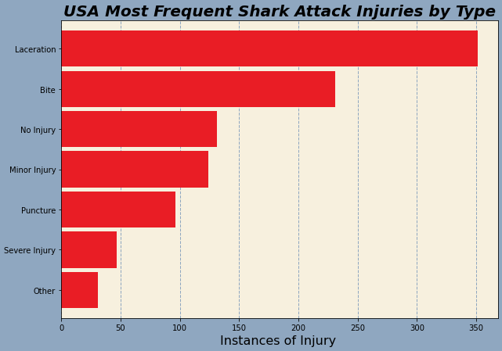
Shark Attacks by Injury Type
Shark Attacks in the USA
Shark Attacks – An exploratory data analysis

Slide 29
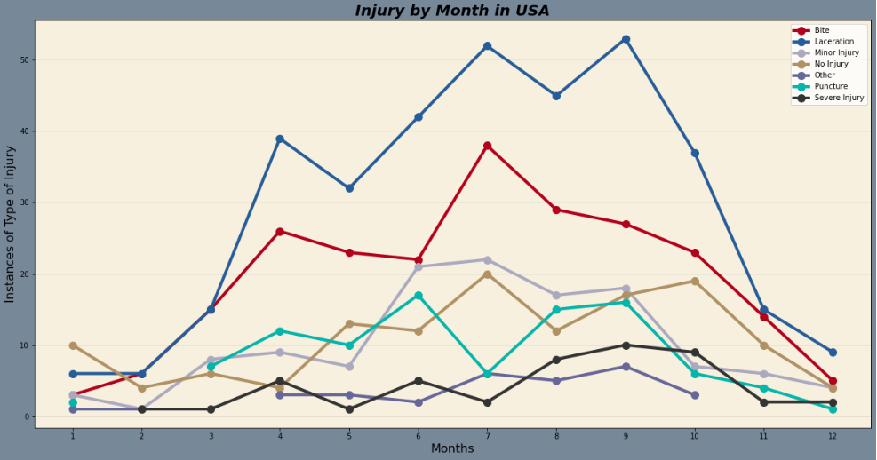
Shark Attacks – An exploratory data analysis

Slide 30
When have shark attacks been most reported?

Slide 31
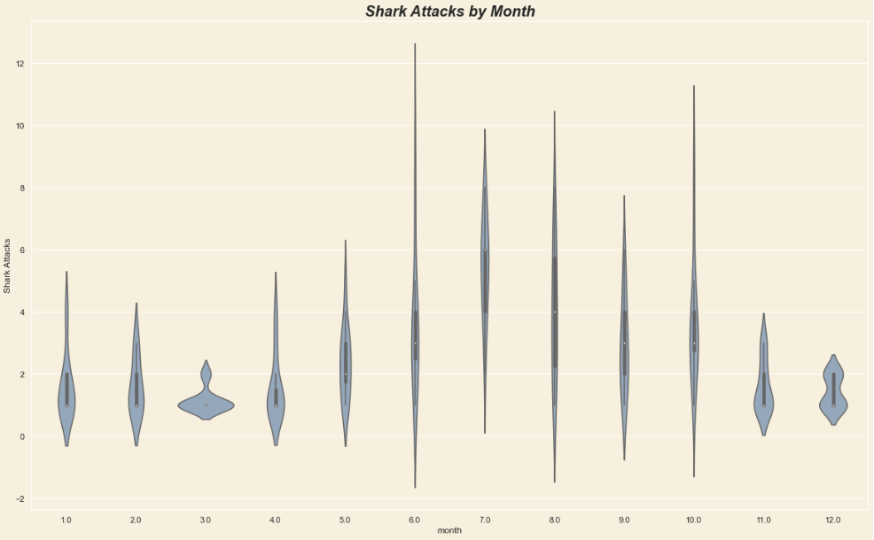
Shark Attacks by Month
Shark Attacks in the USA

Slide 32
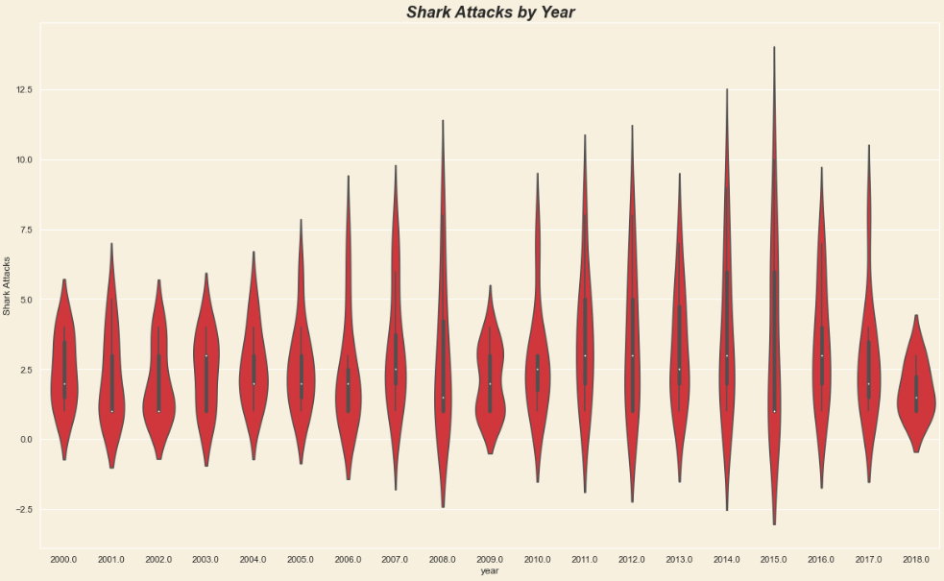
Shark Attacks by Year
Shark Attacks in the USA

Slide 33
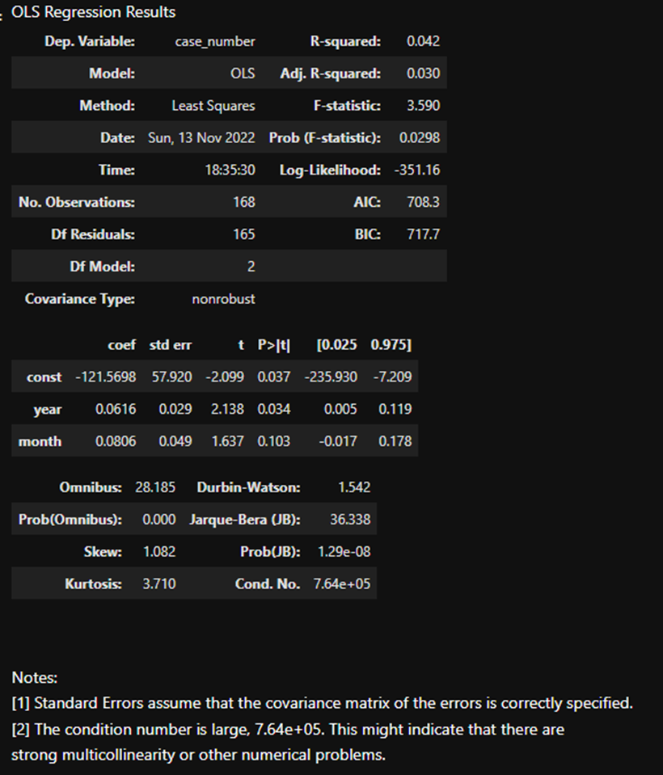
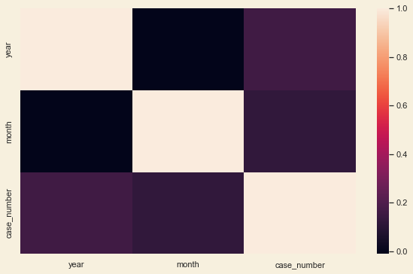
Exploring Shark Attack Data
Shark Attacks in Florida
Shark Attacks – An exploratory data analysis

Slide 34
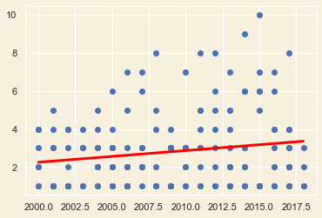
Linear Regression
Florida Reports by year
Given our data so far, we can see that our variance of attacks is incoherent. This makes it difficult to accurately predict the consistency of attacks in Florida. However, because the regression is at the very least, increasing over time. This backs our hypothesis that as population increases over time then so will the amount of reported Shark Attacks

Slide 35
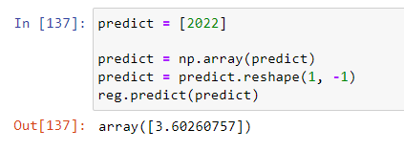
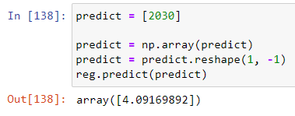
Linear Regression
Florida Reports by year – Predictions
Our hypothesis that reported shark attacks will continue to rise with increased population shows to be true based on the predictions shown for 2022 and 2030.

Slide 36
Data Limitations
Case Reports have missing data like the age, gender, and type of shark
Lack of reporting around the world
What is considered a shark attack is subjective, there were several that may not have been shark related

Slide 37
Conclusion
Based on the data that was analyzed:
Fatal shark attacks are very rare, making up for ~2% of reported shark attacks
Reported attacks are slightly increasing
Florida has the most reported shark attacks
Men are 3x more likely than women to be reported attacked by a shark
July – September have the most reported shark attacks, and November – March with the least.

Slide 38
Data Location
file:///C:/Users/brenn/SMU_Bootcamp/Projects/project_1_group_3/smu_project1_sharkattacks/smu_project1_sharkattacks/bee_work/export.html

Slide 39
Thank you!
Questions?

